Slide 1
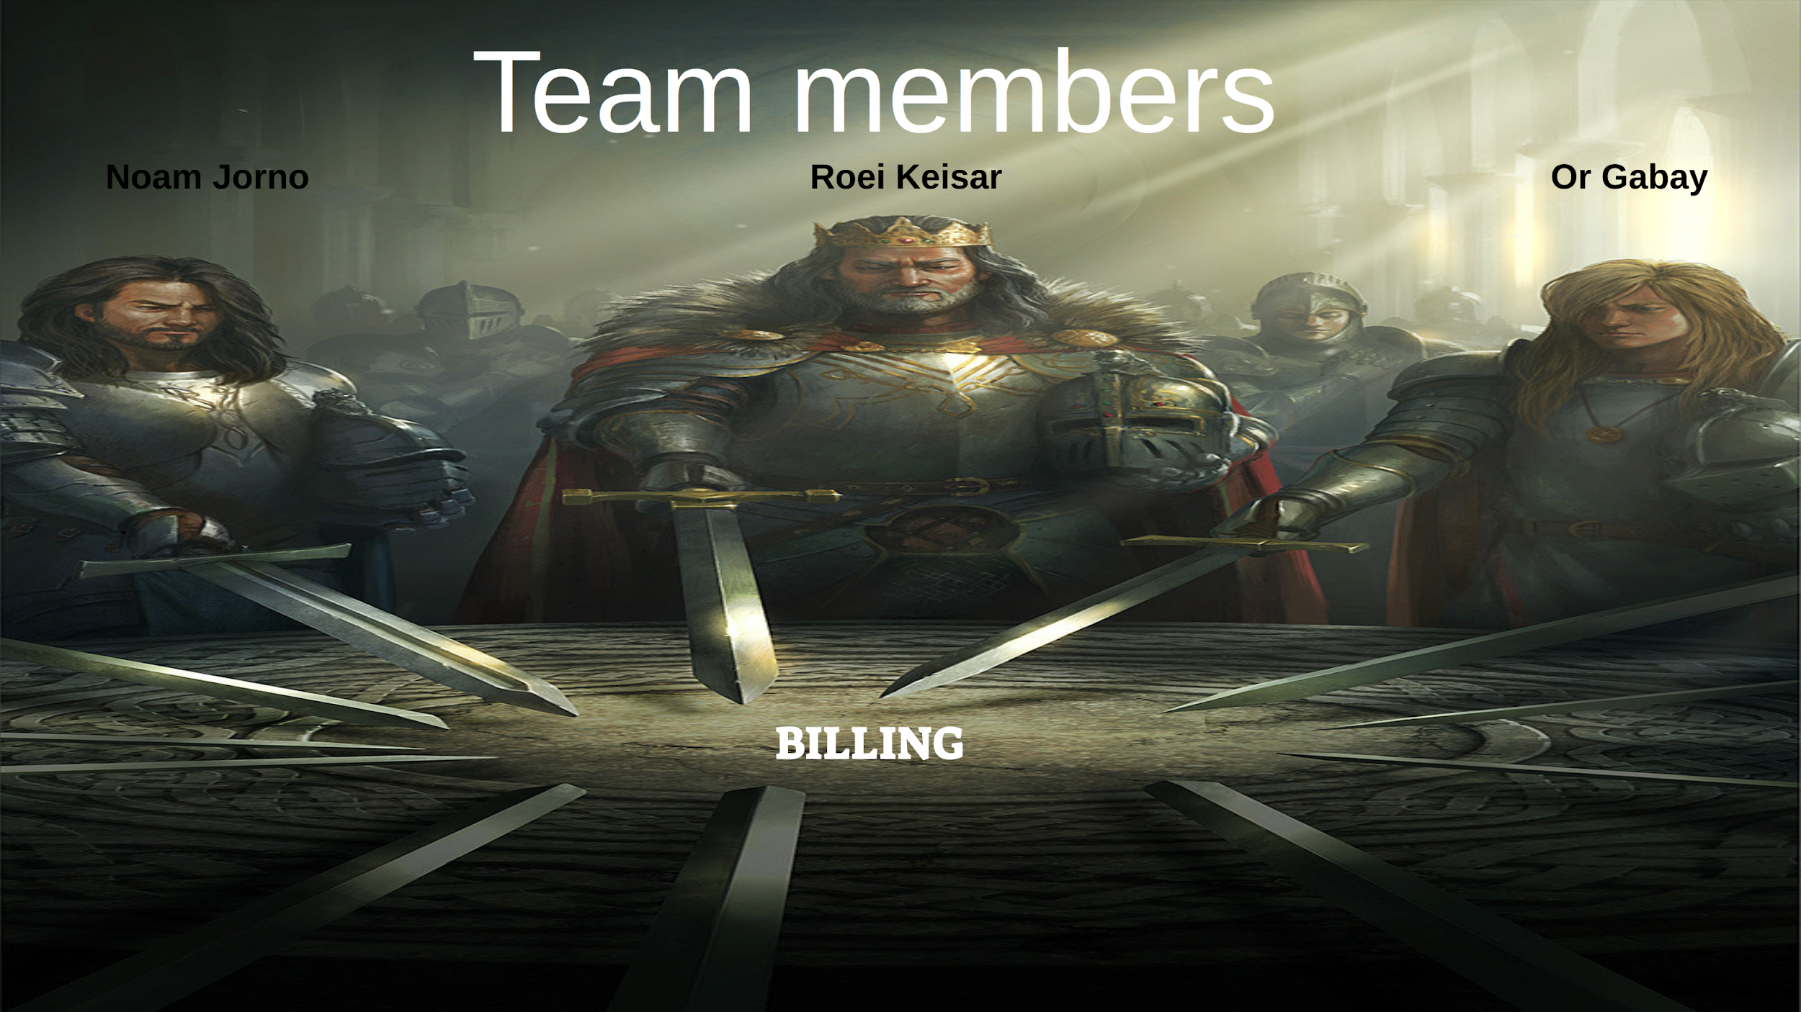

Team members
Noam Jorno
Roei Keisar
Or Gabay
BILLING

Slide 2
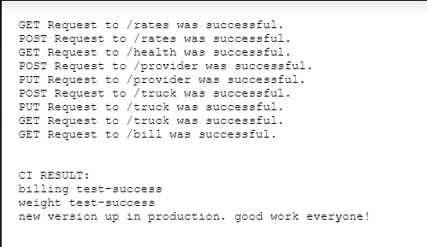
billing team task
To write a new producer (fruit providers) billing system- APIS:
Enter a new provider into the system (POST /provider API)
Updates provider name (PUT /provider/<id>)
Upload/update a list of fruit rates (POST /rates)
Present the current rate list (GET /rates)
Registered a truck in the system (POST /truck)
Update provider id (PUT /truck/<id>)
Return tara and sessions (GET /truck/<id>)
Provide the invoice according to the dates and the quantity of goods for each supplier(GET /bill/<id>)

Slide 3

Git strategy
Working on billing branch, and whenever done working on something locally, pushing (by admin) to origin:billing

Slide 4
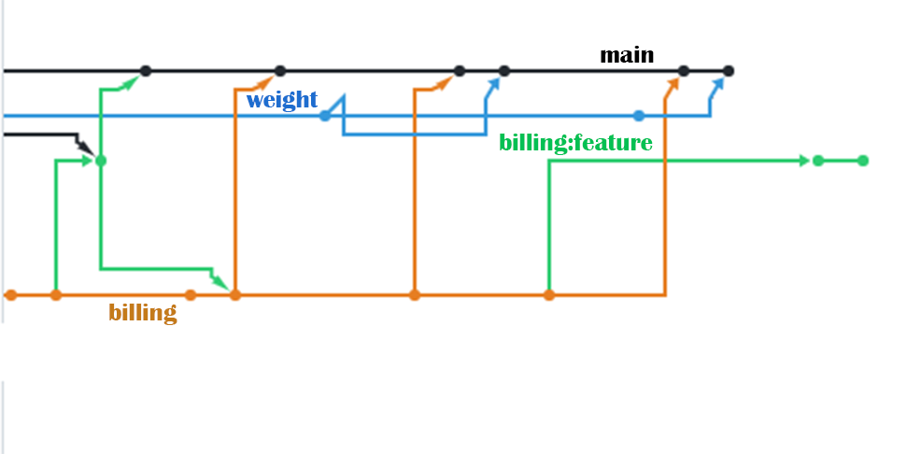


Slide 5
challenges
New technologies .
Working from remote.
Bridge gaps between teams .
Working without experience.

Slide 6
How did we deal with the challenge?
Mindset of learning as much we could .
Trying to first solve the big picture problems and then go after the small bug fixes.
monitoring tasks with “Trello”.

Slide 7
improve | keep
Division of tasks and working with trello. Don't focus only on the current day's tasks, but also look at the rest of the tasks. We must define the free time at the day to do our chores. | Despite the difficulty, we managed to make the daily goals. Efficient and fast work Good group work and helping each other Consult with other teams Ambition

Slide 8


Slide 9

thank you

